Slide 1
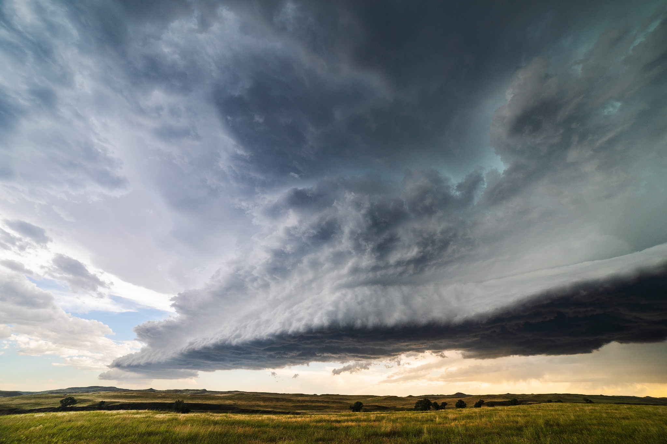
The Impact of Severe Weather Conditions
on Flight Operation
The August 2020 Midwest Derecho (USA)
Victor, Lis, Julia, Sasan

Slide 2
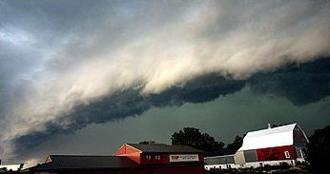
The Weather Event Description
The August 2020 Midwest Derecho
Definition: A derecho is a wind storm
Time: August 10, 2020 8am - 7pm
Location: the Midwestern United States
Characteristics: high winds, torrential rain,thunderstorms, shift in temperature and air pressure

Slide 3
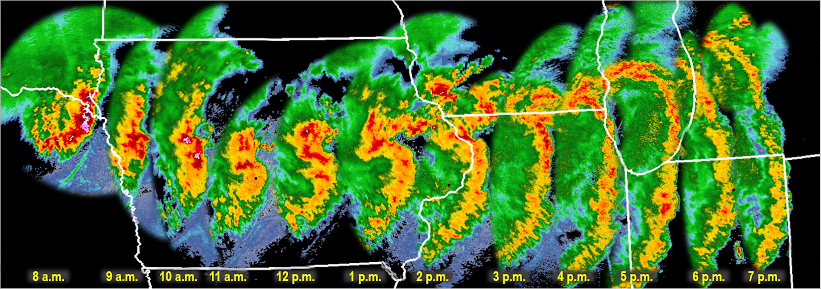

The Spread of the August 2020 Midwest Derecho

Slide 4
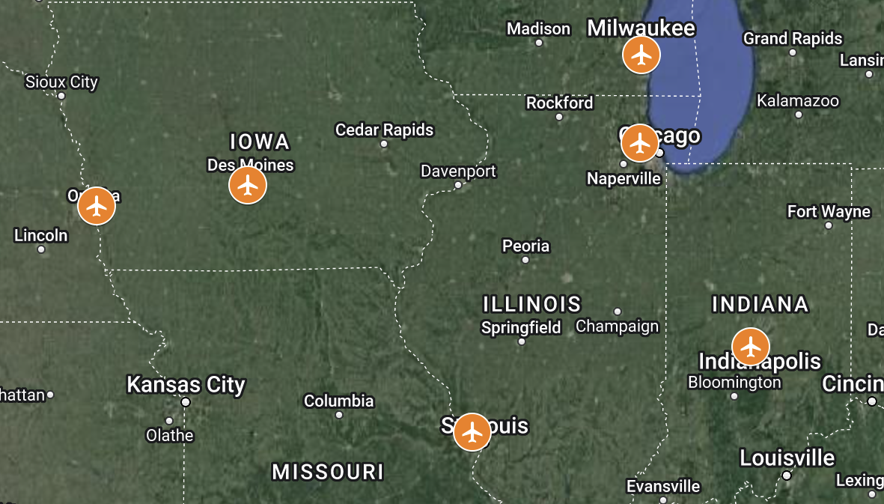
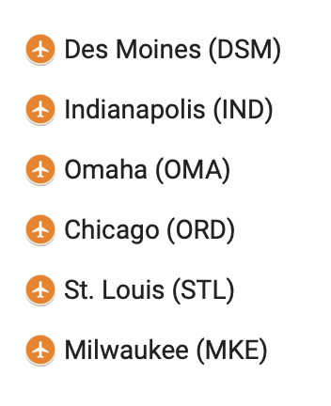
Case Studies: Selected Midwest Airports
MKE
ORD
OMA
DSM
IND
STL

Slide 5
Data Sources
Weather Data: Meteostat
hourly point data for the 6 airports for August 2020
* Meteostat provides historical daily statistics for any geographic location, aggregated from multiple governmental interfaces.
Flights Data: U.S. Bureau of Transportation Statistics
Where the 6 airports are origin and/or destination for August 2020

Slide 6
Hypotheses
The August 2020 Midwest Derecho is reflected in the weather data as a spike in wind speed, precipitation levels, abrupt shift in air pressure and/or temperature
The weather event led to an increase in flight cancellation and diversion.
In accordance with the thunderstorm direction, the western airports started rearranging their flight schedules earlier than other airports.

Slide 7
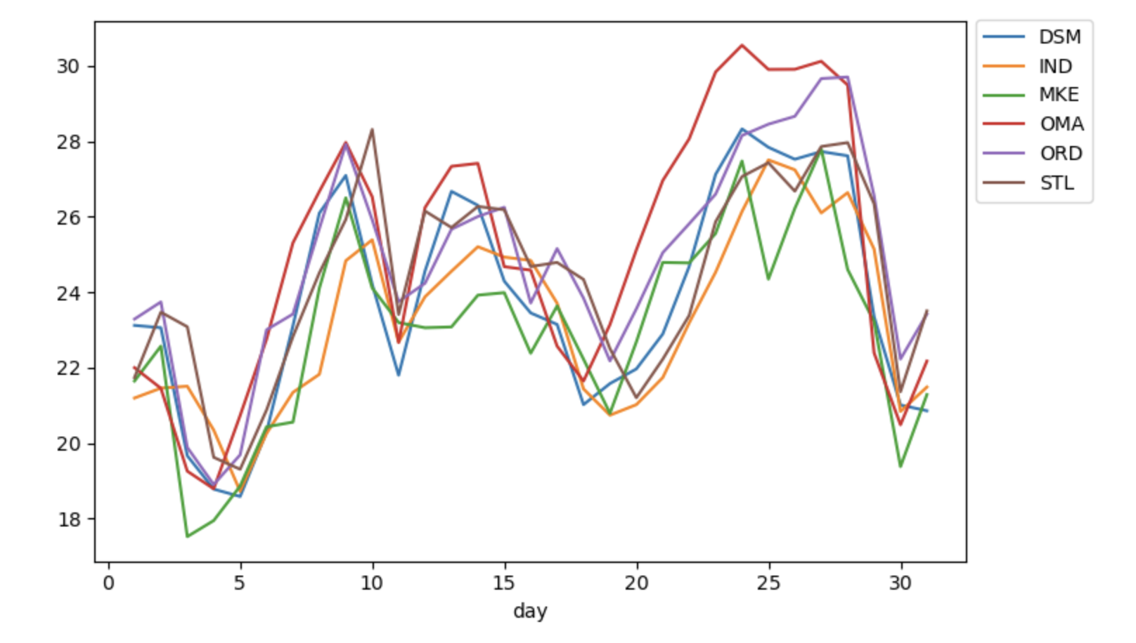
Hypothesis I: Derecho is reflected in the weather data
Average temperature per day in August 2020 (C°)

Slide 8
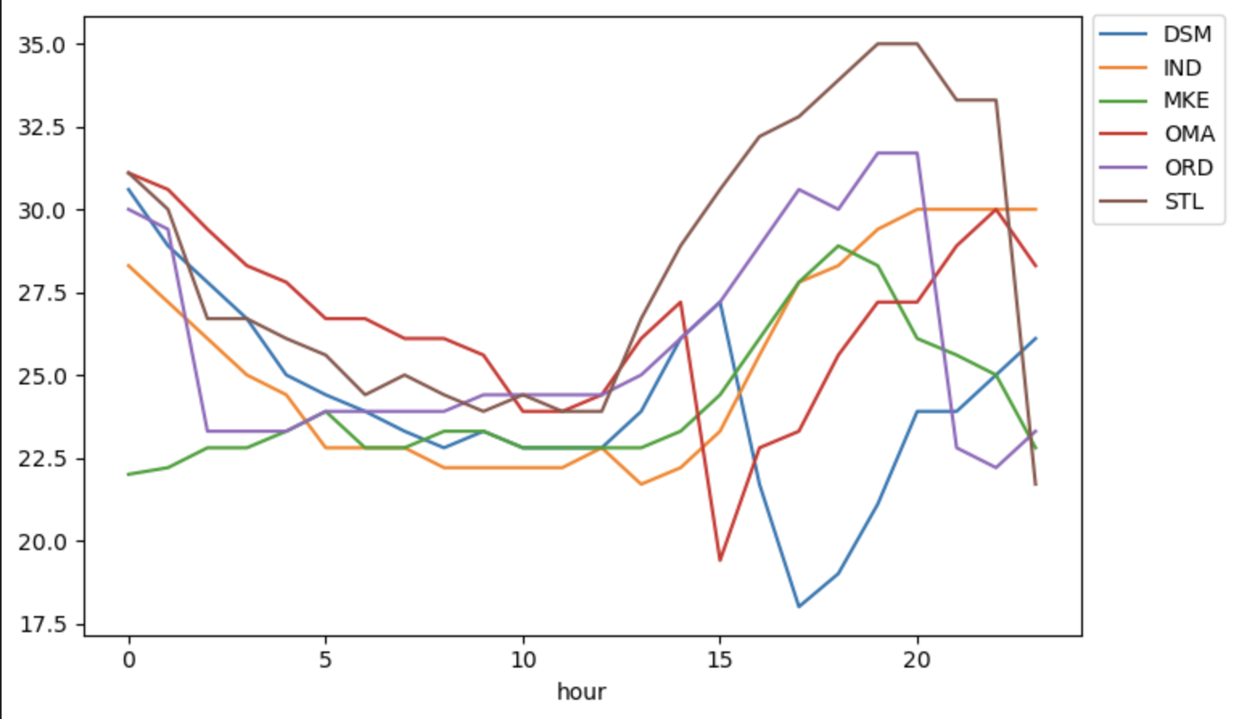
Hypothesis I: Derecho is reflected in the weather data
Hourly temperature on August 10th 2020 (C°)

Slide 9
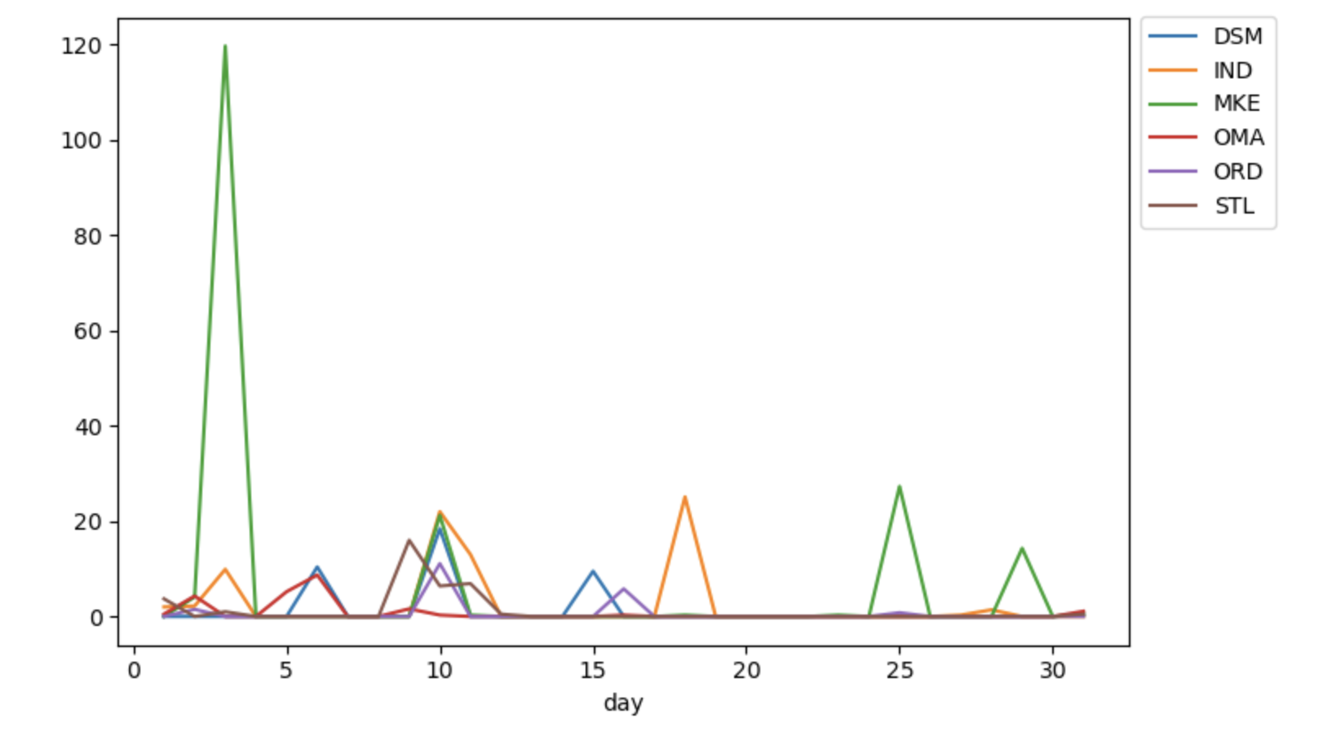
Hypothesis I: Derecho is reflected in the weather data
Total precipitation per day in August 2020 (mm)

Slide 10
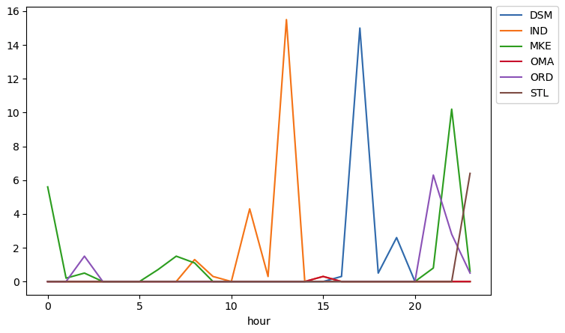
Hypothesis I: Derecho is reflected in the weather data
Hourly precipitation on August 10th 2020 (mm)

Slide 11
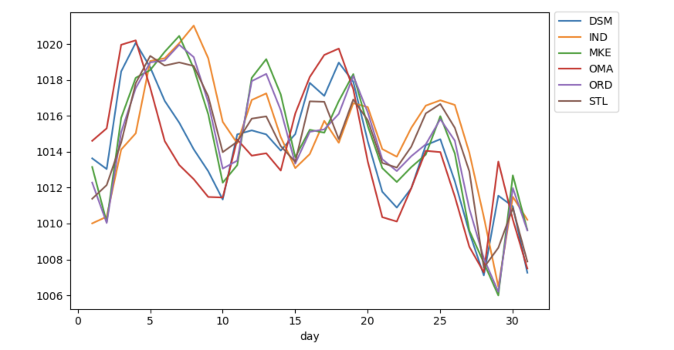
Hypothesis I: Derecho is reflected in the weather data
Average air pressure per day in August 2020 (h/Pa)

Slide 12
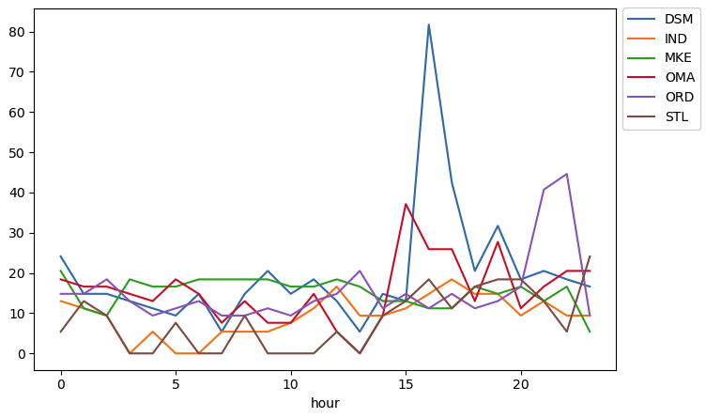
Hypothesis I: Derecho is reflected in the weather data
Wind speed on August 10th 2020 (km/h)

Slide 13
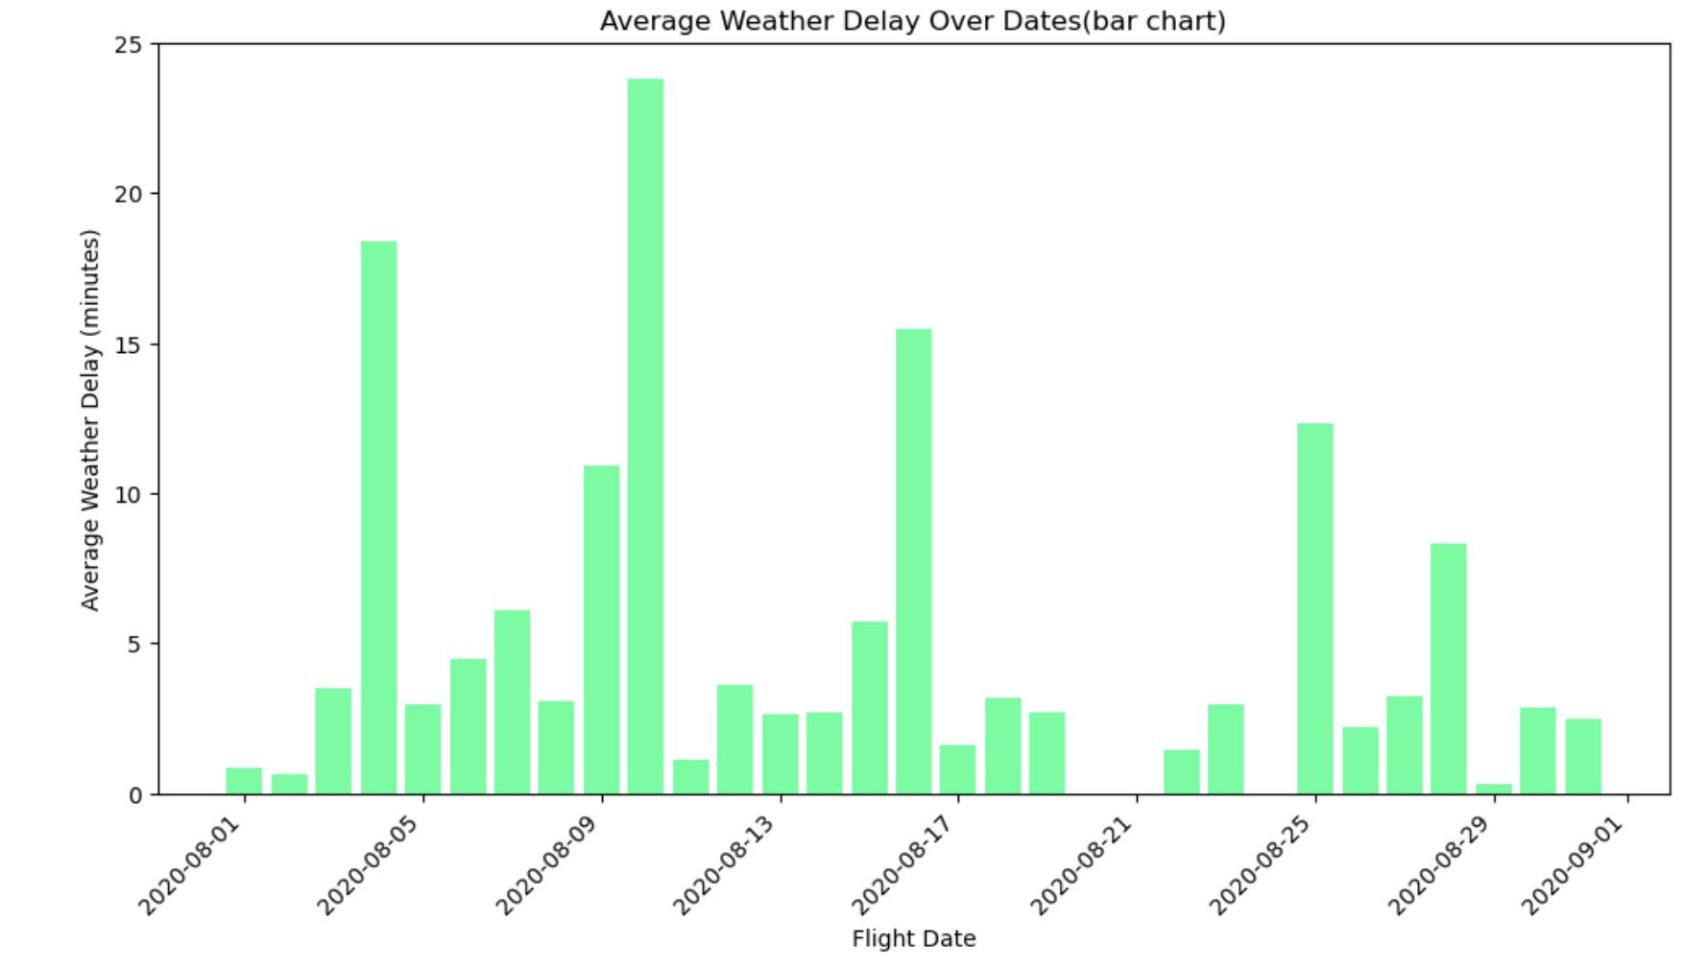
Hypothesis II: Flight rearrangement spiked on August,10
Average delay caused by weather conditions

Slide 14
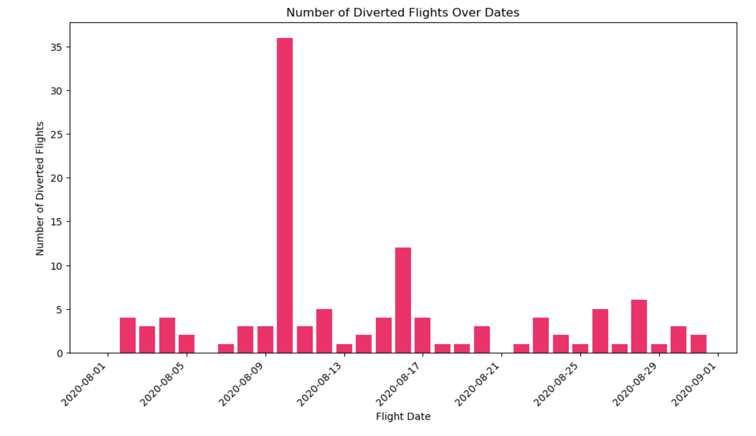
Hypothesis II: Flight rearrangement spiked on August,10
Number of diverted flights per day in August 2020

Slide 15
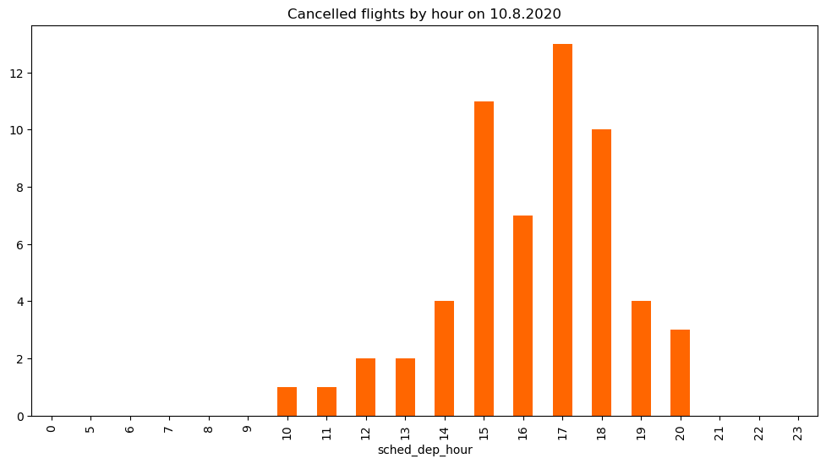
Hypothesis II: Flight rearrangement spiked on August,10
Number of cancelled flights by hour on August 10

Slide 16
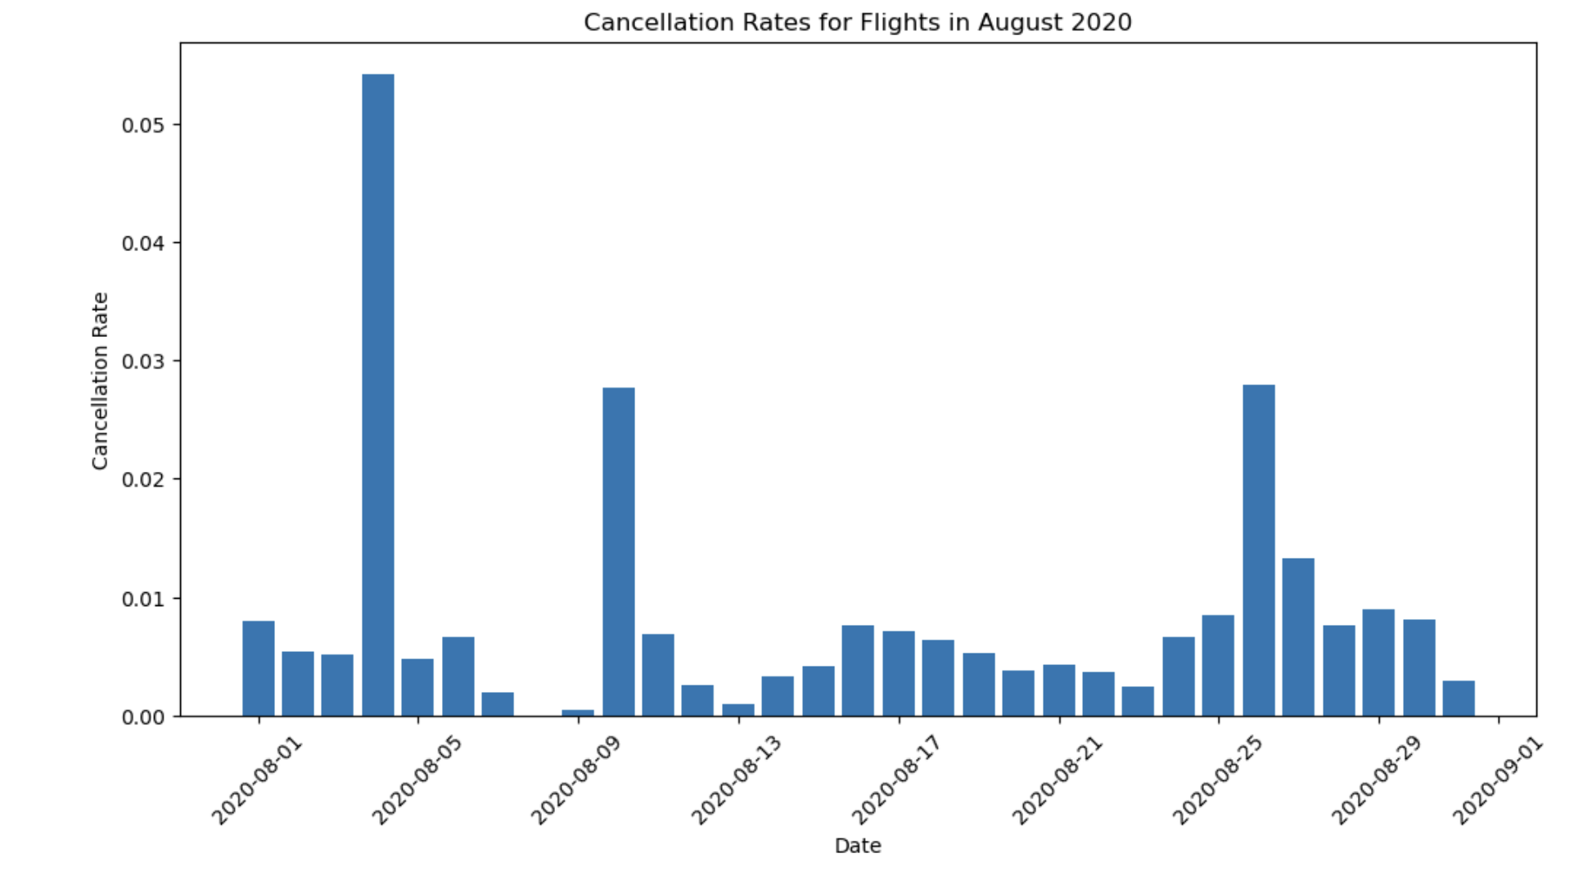
Hypothesis II: Flight rearrangement spiked on August,10
Cancellation rate per day in August 2020

Slide 17
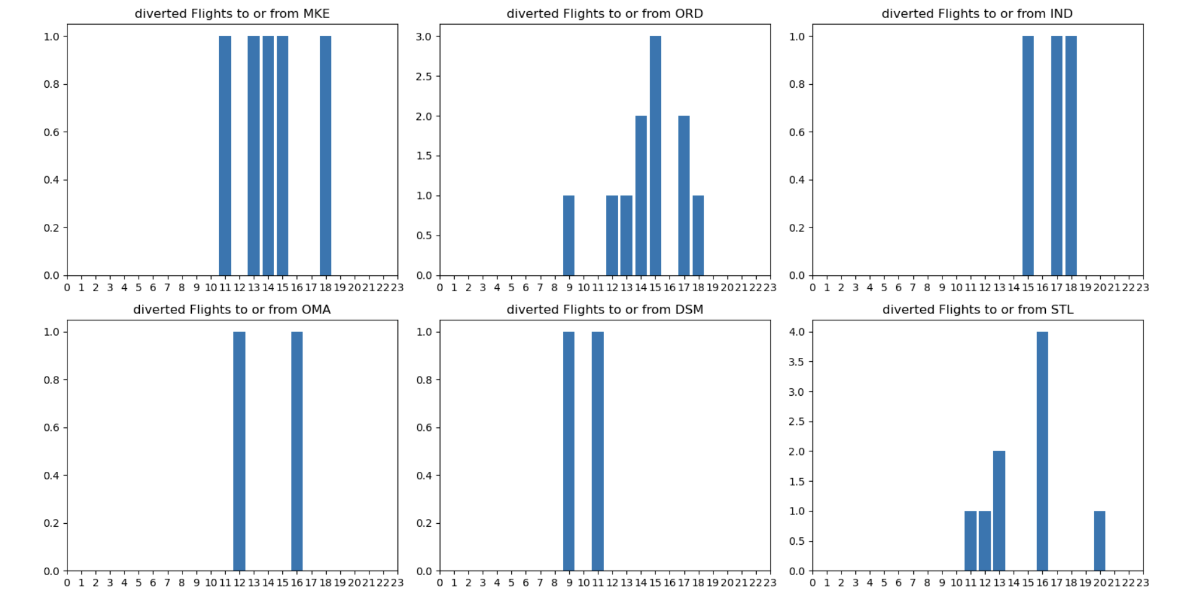
Hypothesis III: Derecho impacted OMA and DSM operations on the earliest
Diverted flights on August 10 at selected airports

Slide 18
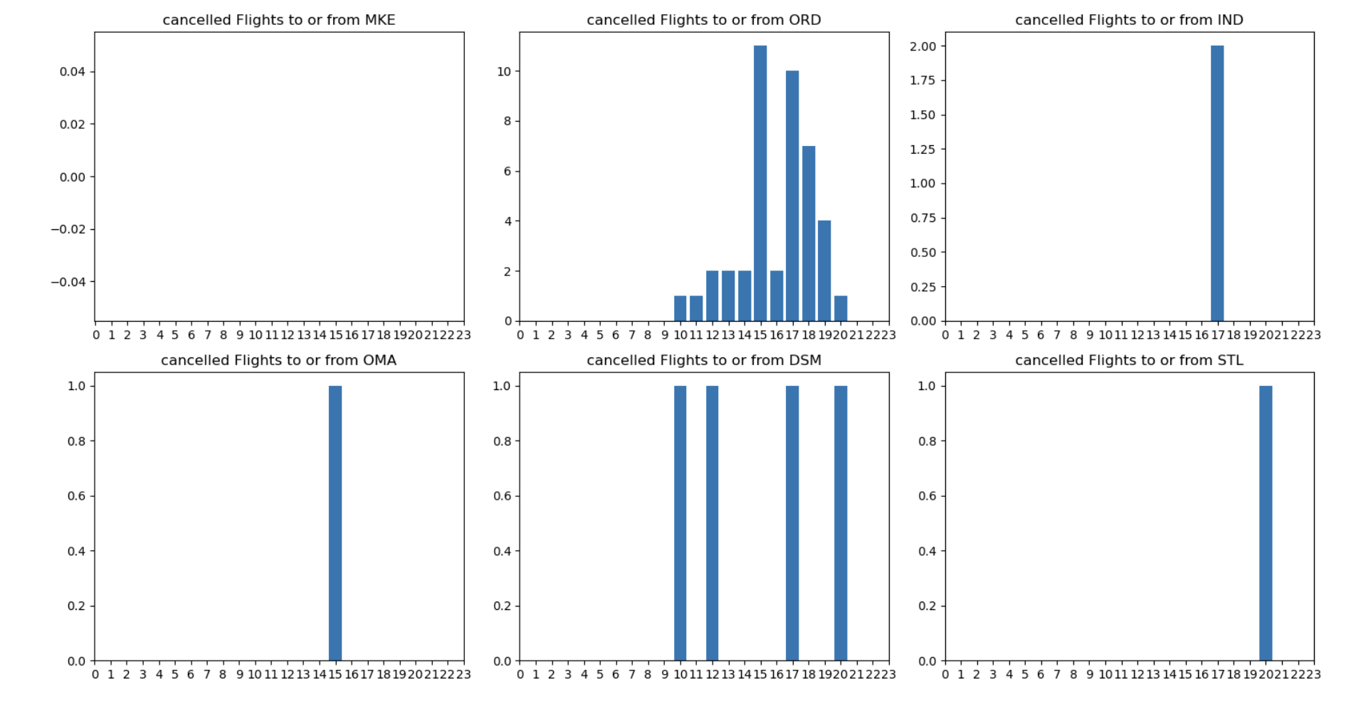
Hypothesis III: Derecho impacted OMA and DSM operations on the earliest
Cancelled flights on August 10 at selected airports

Slide 19
MKE
ORD
OMA
DSM
IND
STL

Slide 20
Conclusion
The August 2020 Midwest Derecho is reflected in the weather data as a an abrupt change in weather conditions.
There is an increase in flight cancellation and diversion on August, 10.
The hypothesis that the airports in Omaha and Des Moines, being the western ones hit by the thunderstorm first, would start rearranging flight schedules earlier, was not confirmed.

Slide 21
Discussion
Hypothesis III, that the airports in Omaha and Des Moines, being the most western ones hit by the thunderstorm first, would start rearranging flight schedules earlier, was not confirmed.
Suggestions for further exploration:
Apart from cancelled and diverted flights, check delays
Explore airport size and schedules
Check directions of the flights

Slide 22
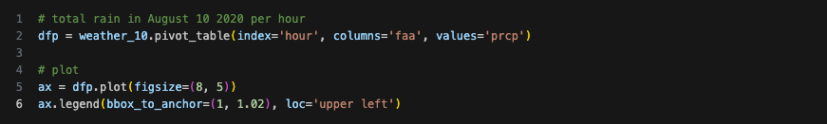
Codes
Pivot Table

Slide 23
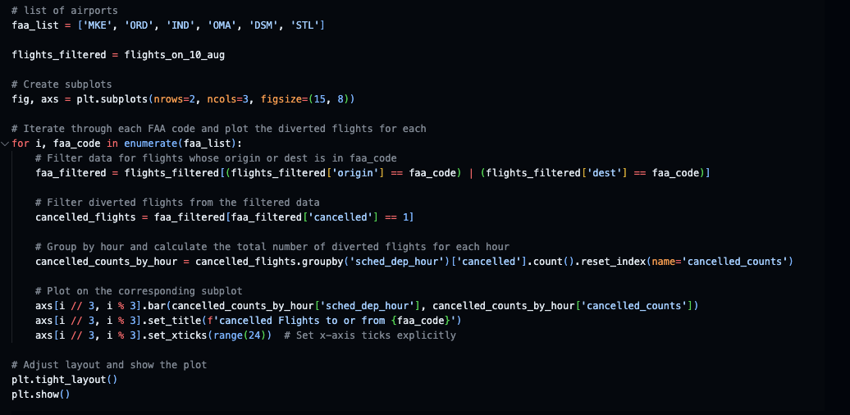
Codes
Cancellation plot for all 6 airports

